Slide 1
Chapter 2
Instructions: Language of the Computer
Notes:
The University of Adelaide, School of Computer Science
Chapter 2 — Instructions: Language of the Computer

Slide 2
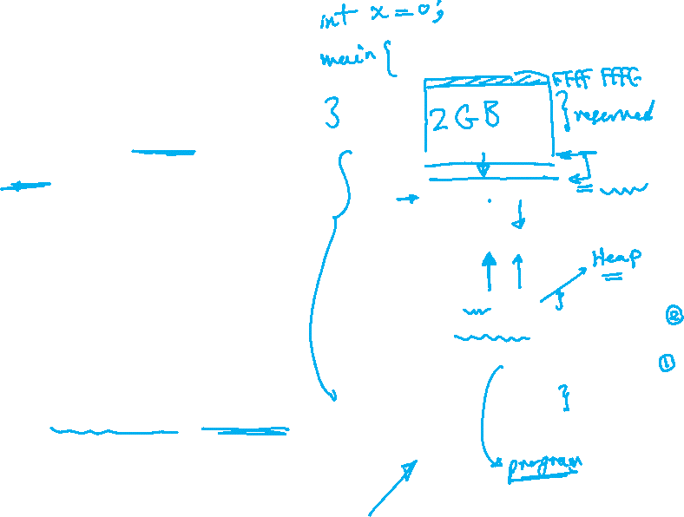
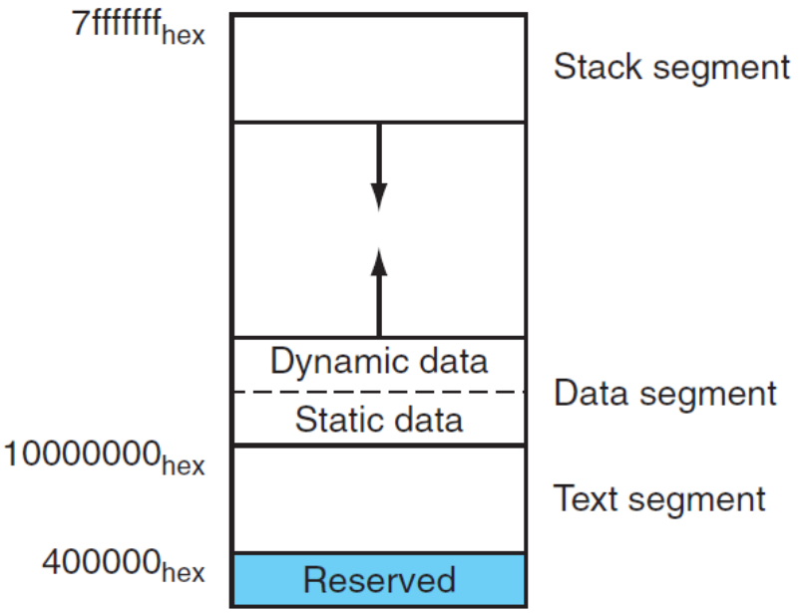
Memory Layout
Text: program code
Static data: global variables
  e.g., static variables in C, constant arrays and strings
  $gp initialized to address allowing ±offsets into this segment
Dynamic data: heap
  E.g., malloc in C, new in Java
Stack: automatic storage
Chapter 2 — Instructions: Language of the Computer — <number>
Notes:
The University of Adelaide, School of Computer Science
Chapter 2 — Instructions: Language of the Computer

